Slide 1
Neighbor Interaction Aware Graph Convolution Networks for Recommendation
SIGIR 2020
Huawei & McGill University
Keyu Chen

Slide 2
Catalogue
Background & Motivations
Innovations
Proposed Model
Experiments
Conclusion & Summary

Slide 3
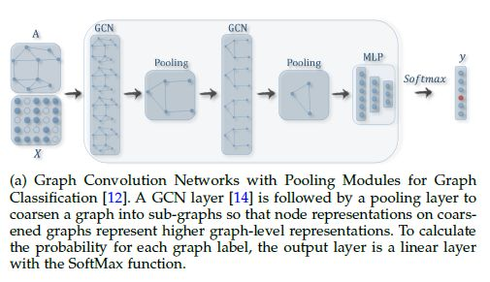
Background
GCN

Slide 4
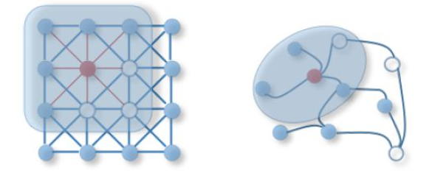
Background
GCN-based representation learning
(1) Neighborhood aggregation;
(2) Center-neighbor combination

Slide 5
Background
GNN-Based Recommender Systems
e.g. PinSAGE, NGCF, et.al
Why GNN for Recommender System?
(1) Data Sparsity & Cold Start
(2) Relational Information

Slide 6
Catalogue
Background & Motivations
Innovations
Proposed Model
Experiments
Conclusion & Summary

Slide 7
Motivation
Existing Problems:
(1) Existing aggregation ignores the relation information between neighbors;
(2) Nodes of items and users should be heterogeneous.

Slide 8
Innovations
(1) Pairwise Neighborhood Aggregation (PNA) for modelling neighbor information;
(2) A Parallel GCN Framework;
(3) Cross Depth Ensemble (CDE) for aggregation in GCN.

Slide 9
Catalogue
Background & Motivations
Innovations
Proposed Model
Experiments
Conclusion & Summary

Slide 10
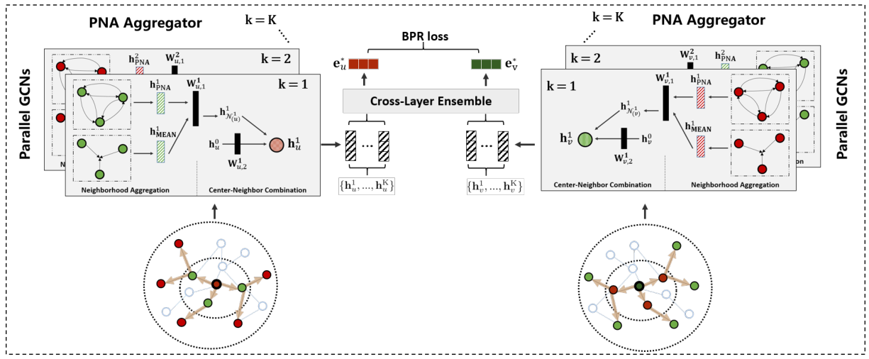

Proposed Model

Slide 11
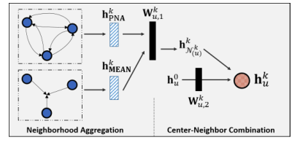
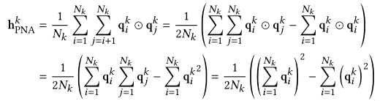
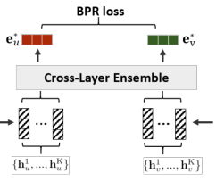
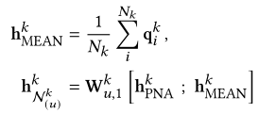

PNA Layer
Neighborhood Aggregation
Center-Neighbor Combination

Slide 12
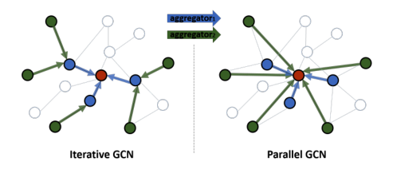
Parellel-GCN

Slide 13
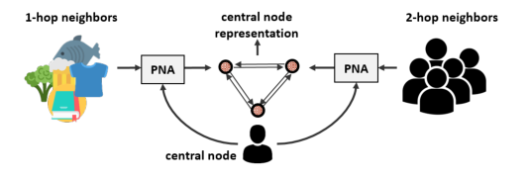
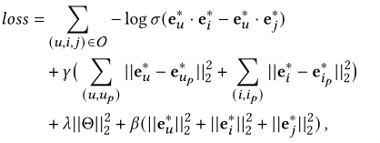
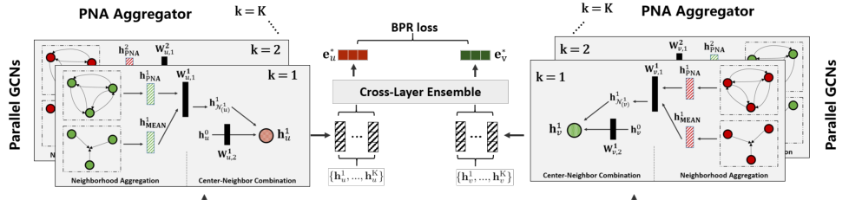
Cross-Depth-Ensemble

Slide 14
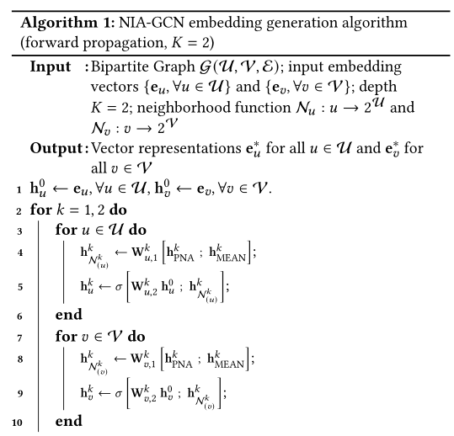
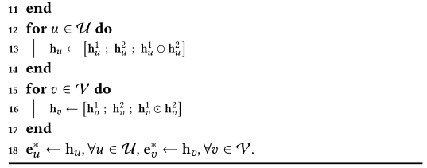
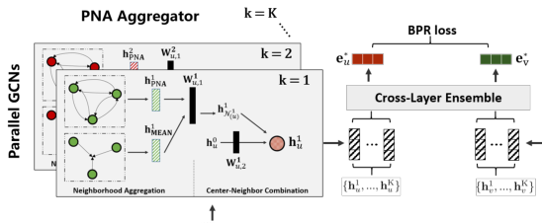
Algorithm Overview

Slide 15
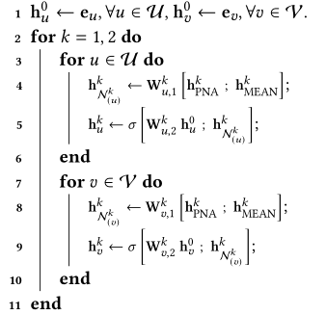
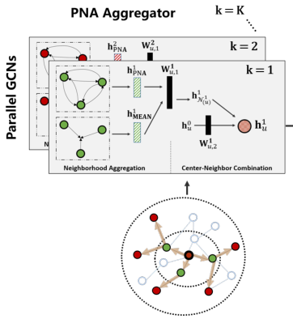
Algorithm Overview

Slide 16
Catalogue
Background & Motivations
Innovations
Proposed Model
Experiments
Conclusion & Summary

Slide 17
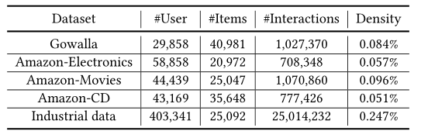
Experiments
Datasets: Gowalla, Amazon
Metrics: Recall@20, NDCG@20
Baselines: BPRMF, NeuMF, GC-MC, PinSAGE, PinSAGE-LSTM, NGCF, GIN

Slide 18
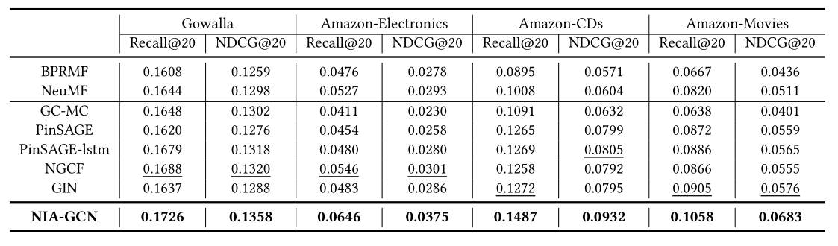
Experiments
Result

Slide 19
Experiments
Analysis (Compared with Baselines)
(1) BPRMF & NeuMF: PNA & CDE learns a more informative representation;
(2) GC-MC & PinSAGE: All neighbors used for aggregation;
(3) NGCF: High-order embedding leads to overfitting;
(4) GIN: Simpler with better performance;
(5) PinSAGE-LSTM: Better than PinSAGE

Slide 20
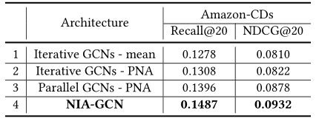
Experiments
Ablation Study (PNA, Parallel, CDE)

Slide 21
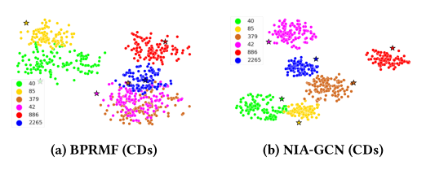
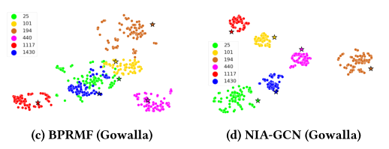
Experiments

Slide 22
Catalogue
Background & Motivations
Innovations
Proposed Model
Experiments
Conclusion & Summary

Slide 23
Conclusion
Three key component:
(1) PNA: neighbor information aggregation
(2) Parallel GCN: better than iteractive GCN
(3) CDE: a new type of aggregation function

Slide 24
Summary
(1) Explicit motivation and clear innovation
(2) Simple but effective improvements
(3) Sufficient Experiments from various aspects
(4) Writing skills remain to be improved

Slide 25
Thanks for listening!
Q & A

